Slide 1


Travel Agency & Tour planning management system

Slide 2
Travel Agency & Tour planning management system
Project Proposal
Information Technology Project (IT2080)
submitted by
IT20172350 – M.P.O.M Gomes
IT20255510 – Y.N Jayasekara
IT20186906 – Tharuka Gayashan F.
IT20046552 – Abeywardhanage S.R. D
IT20204648 – Nethu Nipuna M
IT20163204 – Manimendra N. H
IT20142964 – Dulakshi Hansini R. M
IT20142728 – Ranawaka T. D

Slide 3

Table of content
Introduction 2. System Overview
3. Functions in details 4. Tools & Technologies
5. Work distribution 6. Project management plan
among members

Slide 4
introduction
Company name – Univest travels.
Located in – Matara.
Travel Agency and tour planning Management System is the travel agency which gives all the required facilities to their customers when they are ready to plan for any tour.
By using this System, customer can reserve tour packages.
Customer can reserve tickets, accommodations, and ground recourse.
Provider

Slide 5
Problems and Difficulties, they face
Duplicate data entries.
Building & Maintaining of the system.
Make Booking Procedure more Convenient.
Providing Services as per Specific Requirements.
Get an overall idea about monthly bookings.

Slide 6
solutions
All the data will be recorded in database without any data redundancy
Design User friendly interface
Develop responsiveness of the system
Engaging with various content such as discount, packages, and special budgets
Keep multiple options available for customers to choose one as per their convenience.
Get customers feedback, reviews to improve the service.
Create the system to get report of the booking for month.

Slide 7
Benefits of the system
Customer can reserve travel related things online.
Time Saving.
User Friendliness.
Reduction of errors and delays.
Increased efficiency.
Smarter decisions and strategies.

Slide 8
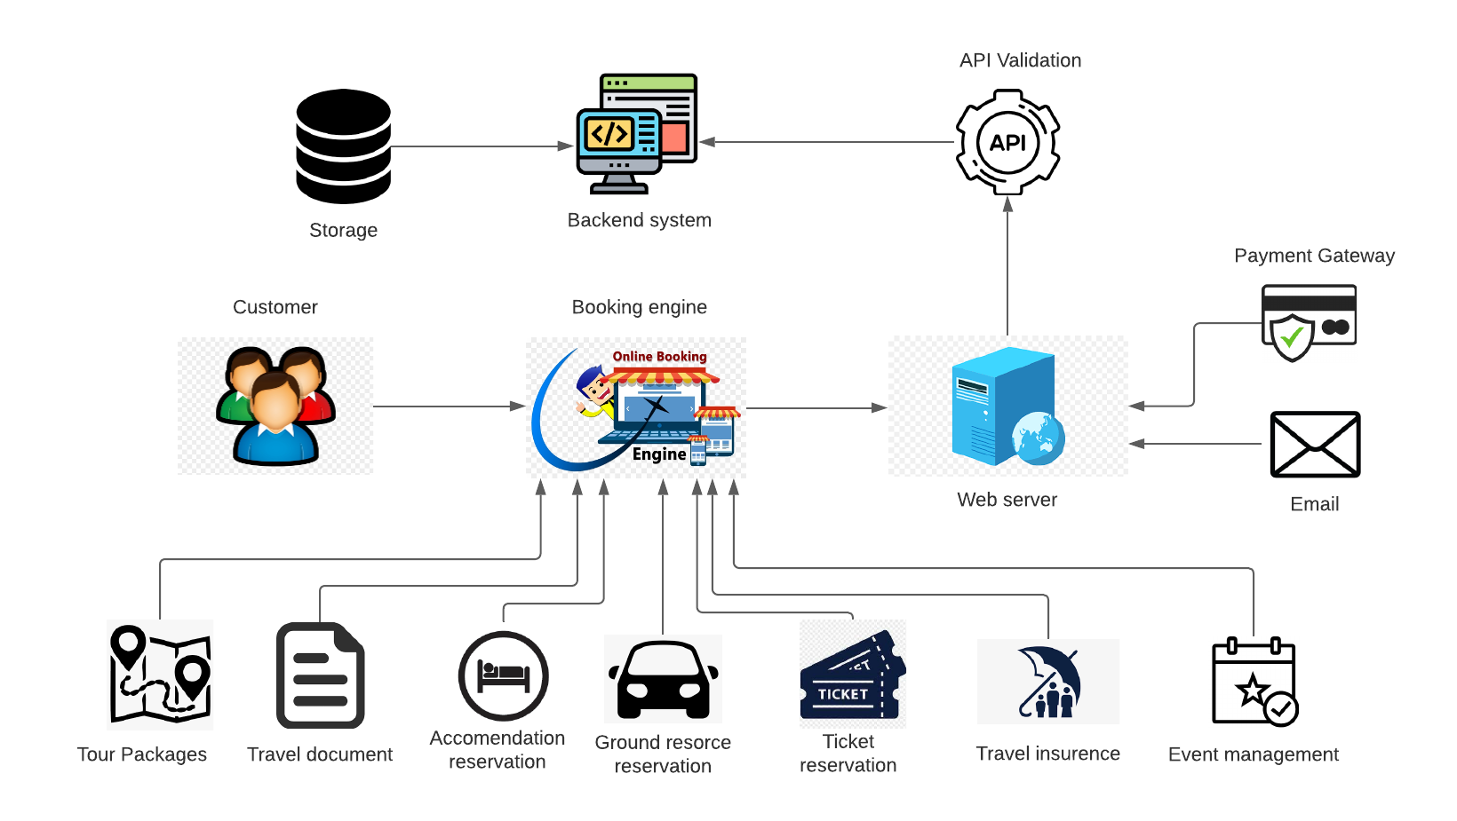
Project overview

Slide 9
System Functions
User Management
User can register to the system
User can login to the system
System can display the login details
Admin can update the user profiles and check the user profiles
Accommodation reservation management
Display (hotel rooms, home stays, resorts, motels) accommodations details
Customer can book accommodations and do money transaction through online payment methods.
Administer can add new accommodations, update details and remove accommodations from the system.
Generate the report who have booked accommodations and daily basis.

Slide 10
Reservation of Ticket Management
Display (Bus, Railway, Airline, Event) ticket details.
Customer can book ticket online and do money transaction through online payment methods.
Administrator can add new tickets, update, and delete tickets.
Generate the report who have booked tickets on daily basis.
Reservation of ground Management
Display reservation item details to Customer.
Customer can book Car, Taxi or a guide and remove their booking.
If the customer makes a reservation, the system saves the customer information to the database.
Send confirmation message to customer

Slide 11
Travel document and travel information management
Display travel information details in frontend.
Customer can send their travel document for travel.
Travel information management admin can add, update, delete travel information.
Visa applicant can check travel documents and if there were any missed document, he / she can inform the customer.
Visa applicant can update, delete travel document.
Visa applicant can get report of visa applied customers details.
Tour Packaging management
Display Tour packages details in frontend.
Customer can reserve tour package , see reserved package details & request for cancel the reservation.
Tour Packages management admin can add , update , delete packages from admin panel.
Tour Packages management admin can get report of total reservations and incomes.

Slide 12
Travel Insurance management
Display Travel Insurance types details.
The customer can reserve an Insurance type, view the reserved insurance type and remove the reserved insurance type.
Travel Insurance Administrator can add, edit and delete insurance types to the system.
The Travel Insurance Administrator can get report from the list of customers who have reserved insurance.
Event management
Display Event types details for customer.
Customer can reserve an event or make an enquire for an event.
Customer can request for cancel the event.
Event management admin can add, update, delete events
Event management admin can get about reserve events details.

Slide 13
Tools & Technologies
Software
Visual Studio Code
Postman
Frontend
React Js
Database
MongoDB
Backend
Node Js
Web server
Express

Slide 14
Work Distribution
User Management IT20142964 - Dulakshi Hansini R.M Create, update, delete and view user profiles. Generate and display the user details. When the unauthorized user access to the admin login page, system will not give the permission to access. | Accommodation reservation management IT20204648 - Nethu Nipuna M Accommodations can be booked and canceled. Create, delete, update, view accommodations. Calculate payment details. Generate report about daily basis.

Slide 15
Reservation of Ticket Management IT20046552 - Abeywardhanage S.R. D Ticket can be booked and canceled. Create, delete, update, view (Bus, Railway, Airline, Event) tickets. Calculate Ticket Payment Details. Generate report about daily basis of Tickets. | Reservation of ground Management IT20186906 - Tharuka Gayashan F Insert, update, view, and delete reservation item details. Making and removing a reservation. Generate customer report. Calculation of reservation payments.

Slide 16
Travel document and travel information management IT20172350 – M.P.O.M Gomes Add Travel documents to the system. Update, view, delete travel documents. Create and view Travel destination information. Update, delete travel destination information. Generate report of visa applied customer details. | Tour Packaging management IT20255510 - Y. N Jayasekara Create and view tour reservation. Form submission to cancelation request. Create , update , delete tour packages. Generate report of reservations and incomes.

Slide 17
Travel Insurance management IT20163204 - Manimendra N. H Create, view, update and delete Travel Insurance types Reserve and remove the reservation of insurance Generate a report of reservation of insurance | Event management IT20142728 – Ranawaka T. D Create ,view , update and delete event types. Reserve and remove the reservation of events. Generate a report of reservation of events

Slide 18
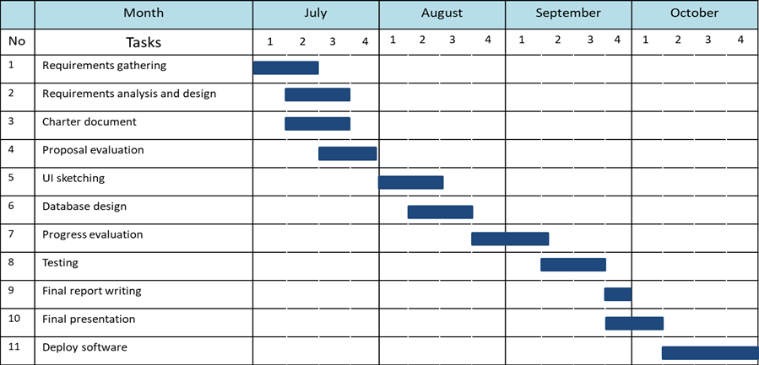
Gantt Chart

Slide 19
Thank You

